Slide 1
Software Architecture Patterns

Slide 2
Software Architecture Pattern
Software architecture is the blueprint of building software
It shows the overall structure of the software, the collection of components in it, and how they interact with one another while hiding the implementation
There are various ways to organize the components in software architecture
These patterns were tried and tested
In each pattern, the components are organized differently for solving a specific problem in software architectures
It offers rules and principles for organizing the interactions between predefined subsystems and their roles.
Software architecture give a clear idea of how the application and its components will function
Productivity will improve when an architecture pattern is in place to clarify the project scope
Most used Software Architecture patterns are:
Layered Pattern
Client-Server Pattern
Event-Driven Pattern
Microkernel Pattern
Microservices Pattern
MVC Pattern

Slide 3
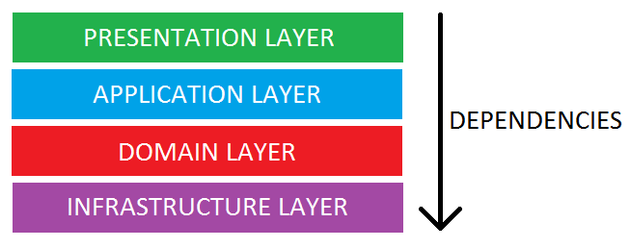
Layered Architecture
Presentation Layer: This is user interface layer where user can interact with application through GUI
Business Layer: It contains business logic as per functionality and request
Application Layer: It acts as medium of communication between “Presentation Layer” and “Data Layer”
Data Layer: Data layer contains database to manage data
This is also called “Multi-layered” or tiered architecture or
N-Tier architecture
This architecture consists of 4 layers
Presentation Layer
Business Layer
Persistence Layer
Data Base Layer
Each Layer plays a distinct role within application and is marked as a closed when work done
It isolates each layer based on functionality it enables to modify one component without impacting other component
Advantages
Less complex due to all the layers follows Separation of Concerns (SoC)
Each layer is independent – understanding each layer will be easy
Dependencies can be reduced between each layer
Disadvantages
Scalability is tough because structure of framework doesn’t allow for growth
Difficult to maintain – change in single layer can impact entire system
Parallel processing not possible

Slide 4
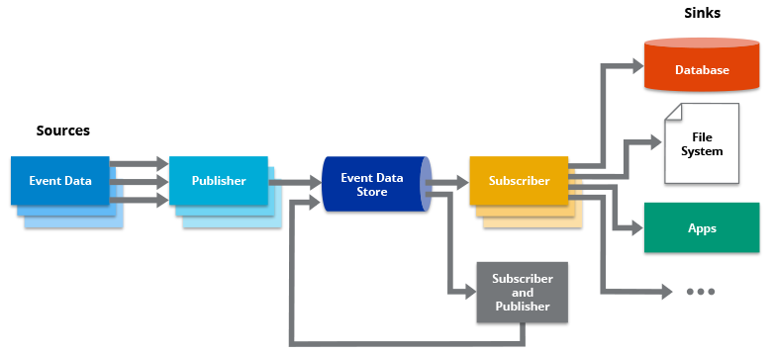
Event Driven Architecture
This pattern is agile and highly performant.
Event-Driven Architecture is an agile approach in which services (operations) of the software are triggered by events.
Examples of events include the taking of a measurement, the pressing of a button, or the swiping of a credit card.
Event-driven architectures Create, Detect, Consume, and react to events
Common concepts in event-driven architectures include Publishers, Subscribers, Sources, and sinks
The Publisher is the component that captures the event data and stores it in a repository
The Subscriber then consumes and potentially responds to the event.
Sources are where the data originates, and sinks are destinations where subscribers send data
Advantages
Loose coupling / decoupling of producers and consumers
Superior fault tolerance
less technical debt
Disadvantages
Increased complexity – with increased events difficult to manage business processes and workflows
Debugging & troubleshooting challenges – Since events are asynchronous – difficult to debug the flow of events

Slide 5
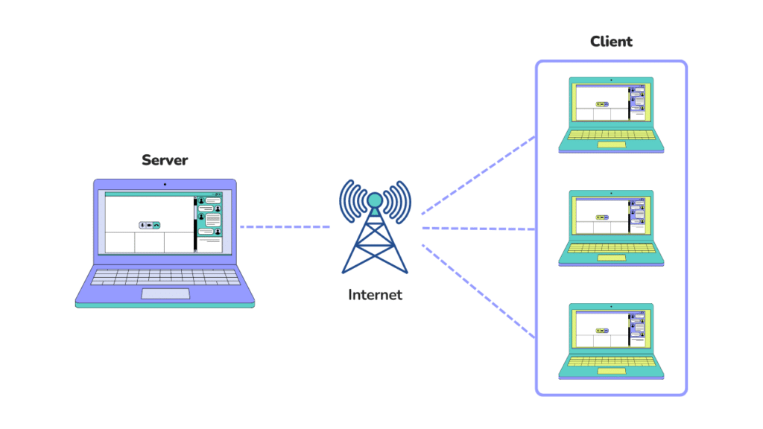
Client-Server Architecture
A client-server architecture pattern is described as a distributed application structure having two main components –a client and a server
This architecture facilitates the communication between the client and the server, which may or may not be under the same network
A client requests specific resources to be fetched from the server, which might be in the form of data, content, services, files, etc.
The server identifies the requests made and responds to the client appropriately by sending over the requested resources
The functionality of this architecture is highly flexible as a single server can serve multiple clients, or a single client can use multiple servers
There can be different types of Client-Server architectures
1-Tier Architecture
2-Tier Architecture
3-Tier Architecture
N-Tier Architecture
Advantages
Centralization: Centralized management of all the info required – network admin have full access & control over server – all issues can be resolved in one place
Adaptability: Number of servers and clients can be easily extendable
Protection – Data is secured due to centralized design of client-server architecture
Disadvantages
Overloading – When too many clients request data from server in parallel – then system might collapse – There can be solution like cluster of server might be needed
Cost: Servers are expensive - Normal system not used

Slide 6
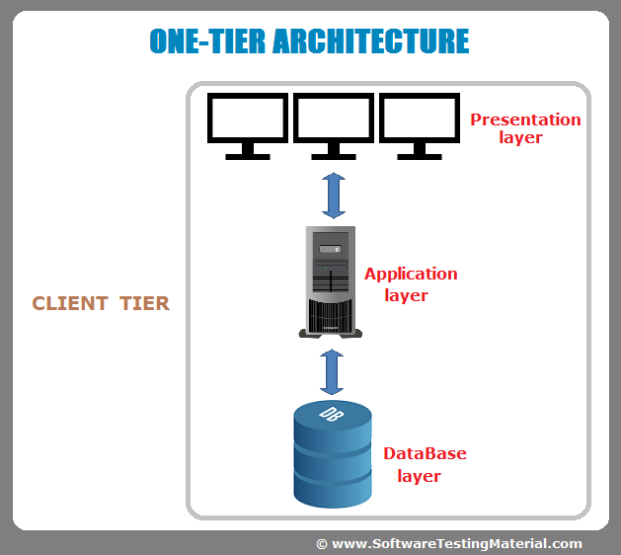
Client-Server Architecture continued …
1-Tier Architecture
In 1-Tier Client Server Architecture, Everything related to the application is grouped and used as a single package to deliver the application
All the logic related to the User Interface, Business Logic, Database Logic, and Database are grouped to make a single entity
A 1-tier architecture offers various services that make it a reliable source, but it is complex to manage
The data variance is the primary problem
A 1-tier architecture involves several layers, including the presentation layer, business layer, and data layer, which are combined using a unique software package
This layer usually stores data within local systems or on a shared drive

Slide 7
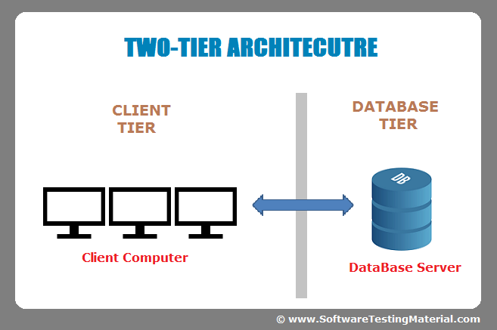
Client-Server Architecture continued …
2-Tier Architecture
In 2-tier Client Server Architecture, the whole application logic is divided into 2 layers
Databases are designed separately and then the main application has all the logic related to the user interface and the business logic and database logic to communicate with the database and process the applications
This architecture has a better environment than the 1-tier architecture.
In comparison to 1-tier architectures, 2-tier architectures are faster since there is no intermediary between the client and the server
The online reservation system is a popular example of a 2-tier architecture

Slide 8
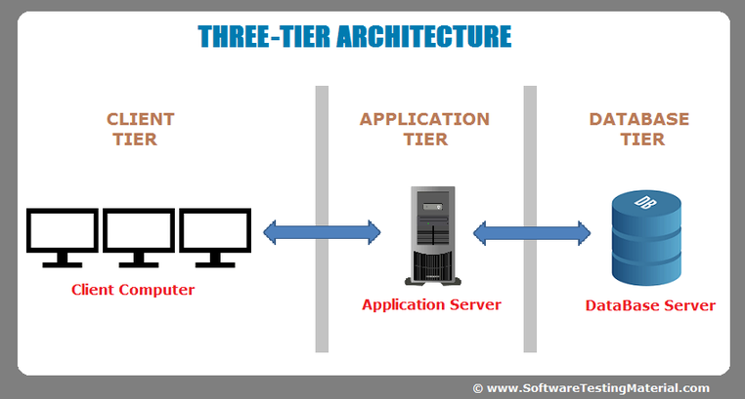
Client-Server Architecture continued …
3-Tier Architecture
A 3-tier system has a middleware between the client and the server
When a client requests information from the server, the request is first received by the middleware
The request will then be sent to the server for processing. Similarly, the server will send a response to the client.
In 3-tier architecture, there are three main layers: presentation layer, application layer, and database layer
Different ends of each layer control each other

Slide 9
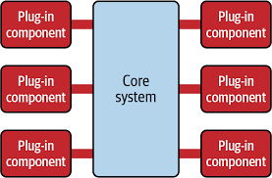
Microkernel Pattern
The microkernel architecture pattern (sometimes referred to as the plug-in architecture pattern) is a natural pattern for implementing product-based applications
A product-based application is one that is packaged and made available for download in versions as a typical third-party product.
The microkernel architecture pattern allows you to add additional application features as plug-ins to the core application, providing extensibility as well as feature separation and isolation.
The microkernel architecture pattern consists of two types of architecture components: a core system and plug-in modules
Application logic is divided between independent plug-in modules and the basic core system, providing extensibility, flexibility, and isolation of application features and custom processing logic
The core system of the microkernel architecture pattern traditionally contains only the minimal functionality required to make the system operational
Advantages
It can react to dynamic change in requirement with minimal impact to system
Easy to plug-in modules which make easy deployment
Testing is easy – Individual modules can be tested
Disadvantages
Not highly scalable because applications will be smaller in size

Slide 10
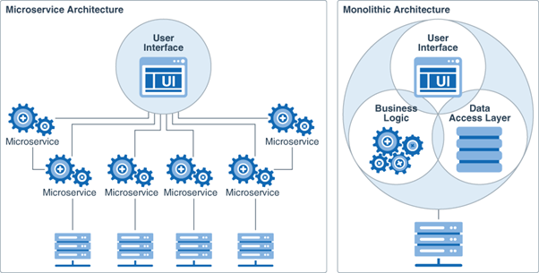
Microservice Pattern
Microservices architecture (often shortened to microservices) refers to an architectural style for developing applications
Microservices allow a large application to be separated into smaller independent parts, with each part having its own realm of responsibility
Within a microservices architecture, each microservice is a single service built to accommodate an application feature and handle discrete tasks
Advantages
Improved fault isolation: Larger applications can remain mostly unaffected by the failure of a single module
Easy of understanding: With added simplicity, developer can easily understand the functionality of service
Smaller and faster deployments: Smaller code bases and scope
Scalability: Each service are independent - can be easily extended
Disadvantages
Communication between services is complex
Each service requires own resource - As number of services increases complexity will increase
Global Testing is difficult – Each layer needs to be verified to confirm it is working
Debugging can be harder – Each service owns set of logs – need to analyze more logs

Slide 11
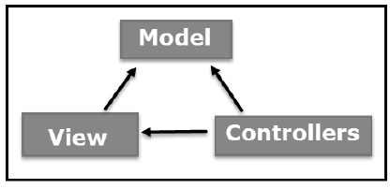
MVC Architecture
The Model-View-Controller (MVC) is an architectural pattern that separates an application into three main logical components
Model
View
Controller
Each of these components are built to handle specific development aspects of an application
MVC is one of the most frequently used industry-standard web development framework to create scalable and extensible projects
Model:

